Slide 1
Week 14 Class 2: CogSec business and future
INST408C: Cognitive Security | Fall 2021 | SJ Terp

Slide 2
INST408C Week
Monday
Project session
Wednesday
CogSec: business landscape, and the future
Readings
NY Times, "inside the disinformation wars"
Harpers, Bad News
Assignments
None (work on your project presentations)
Notes:
Links:

Slide 3
Business
We’ve already been talking about the business of disinformation…

Slide 4
Recap: Cognitive Security Ecosystem
Information Landscape
Information seeking
Information sharing
Information sources
Information voids
Threat
Landscape
Motivations
Sources/ Starting points
Effects
Misinformation Narratives
Hateful speech narratives
Crossovers
Tactics and Techniques
Artifacts
Response
Landscape
Monitoring organisations
Countering organisations
Coordination
Existing policies
Technologies
etc
Notes:
There are many actors in this space. We hear a lot about threat actors - these are at different scales, with different capabilities and motivations. They’re learning from each other, and they often interact - for instance, we see t-shirt sellers picking up geopolitical narratives.

Slide 5
Example Threat Landscape
Motivations
Geopolitics mostly absent
Party politics (internal, inter-party)
Actors
Political parties
Nationstates
Entrepreneurs
Activities
Manipulate faith communities
discredit election process
Discredit/discourage journalists
Attention (more drama)
Potential harms / severities
Assassination
Voting reduction
Sources
WhatsApp
Blogs
Facebook pages
Online newspapers
Media
Routes
Hijacked narratives
Whatsapp to blogs, vice versa
Whatsapp forwarding
facebook to whatsapp
Social media to traditional media
Social media to word of mouth

Slide 6
Business questions
Is there a market here?
Does the market pay enough to sustain businesses?
Where’s the money coming from?
What’s it paying for?
Who is already in this space?
Who is likely to move into this space?
Who is the customer base?
What features and restrictions do we have?
FOLLOW THE MONEY

Slide 7
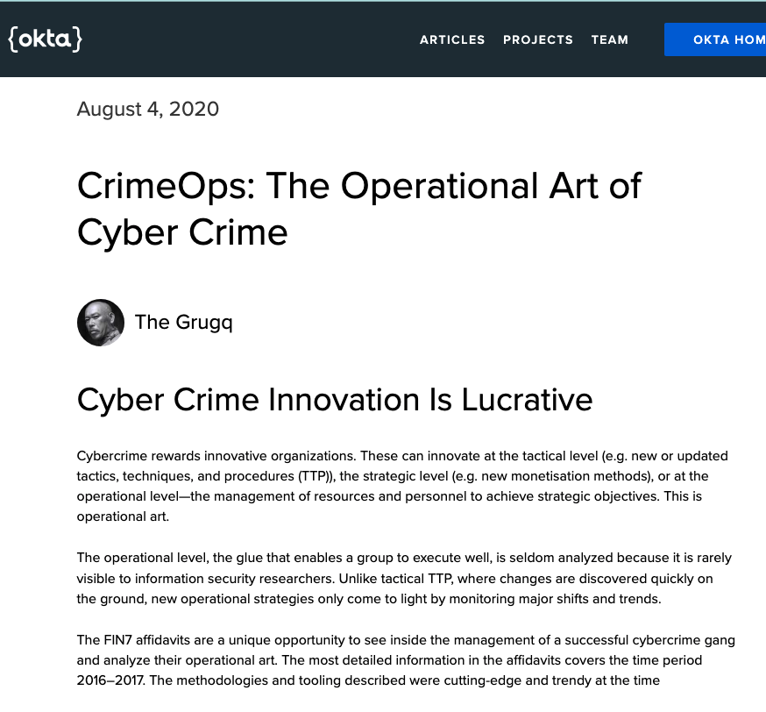
Adjacent markets: ransomware, infosec
Notes:
Links
https://sec.okta.com/articles/2020/08/crimeops-operational-art-cyber-crime

Slide 8
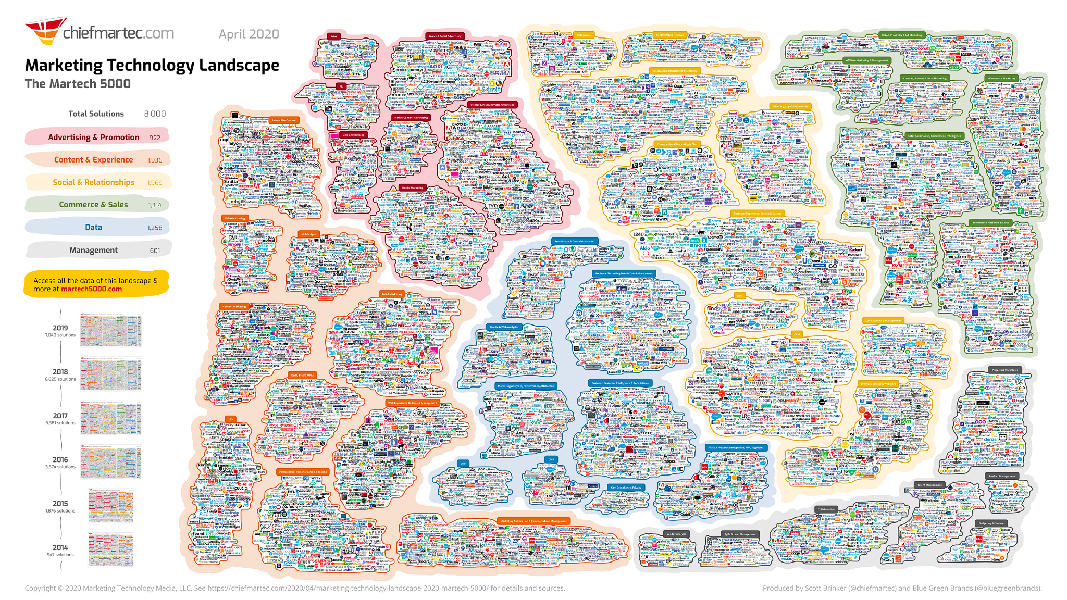
Adjacent/ feeder market: Marketing lumascapes
Notes:
Links:
https://chiefmartec.com/2020/04/marketing-technology-landscape-2020-martech-5000/

Slide 9
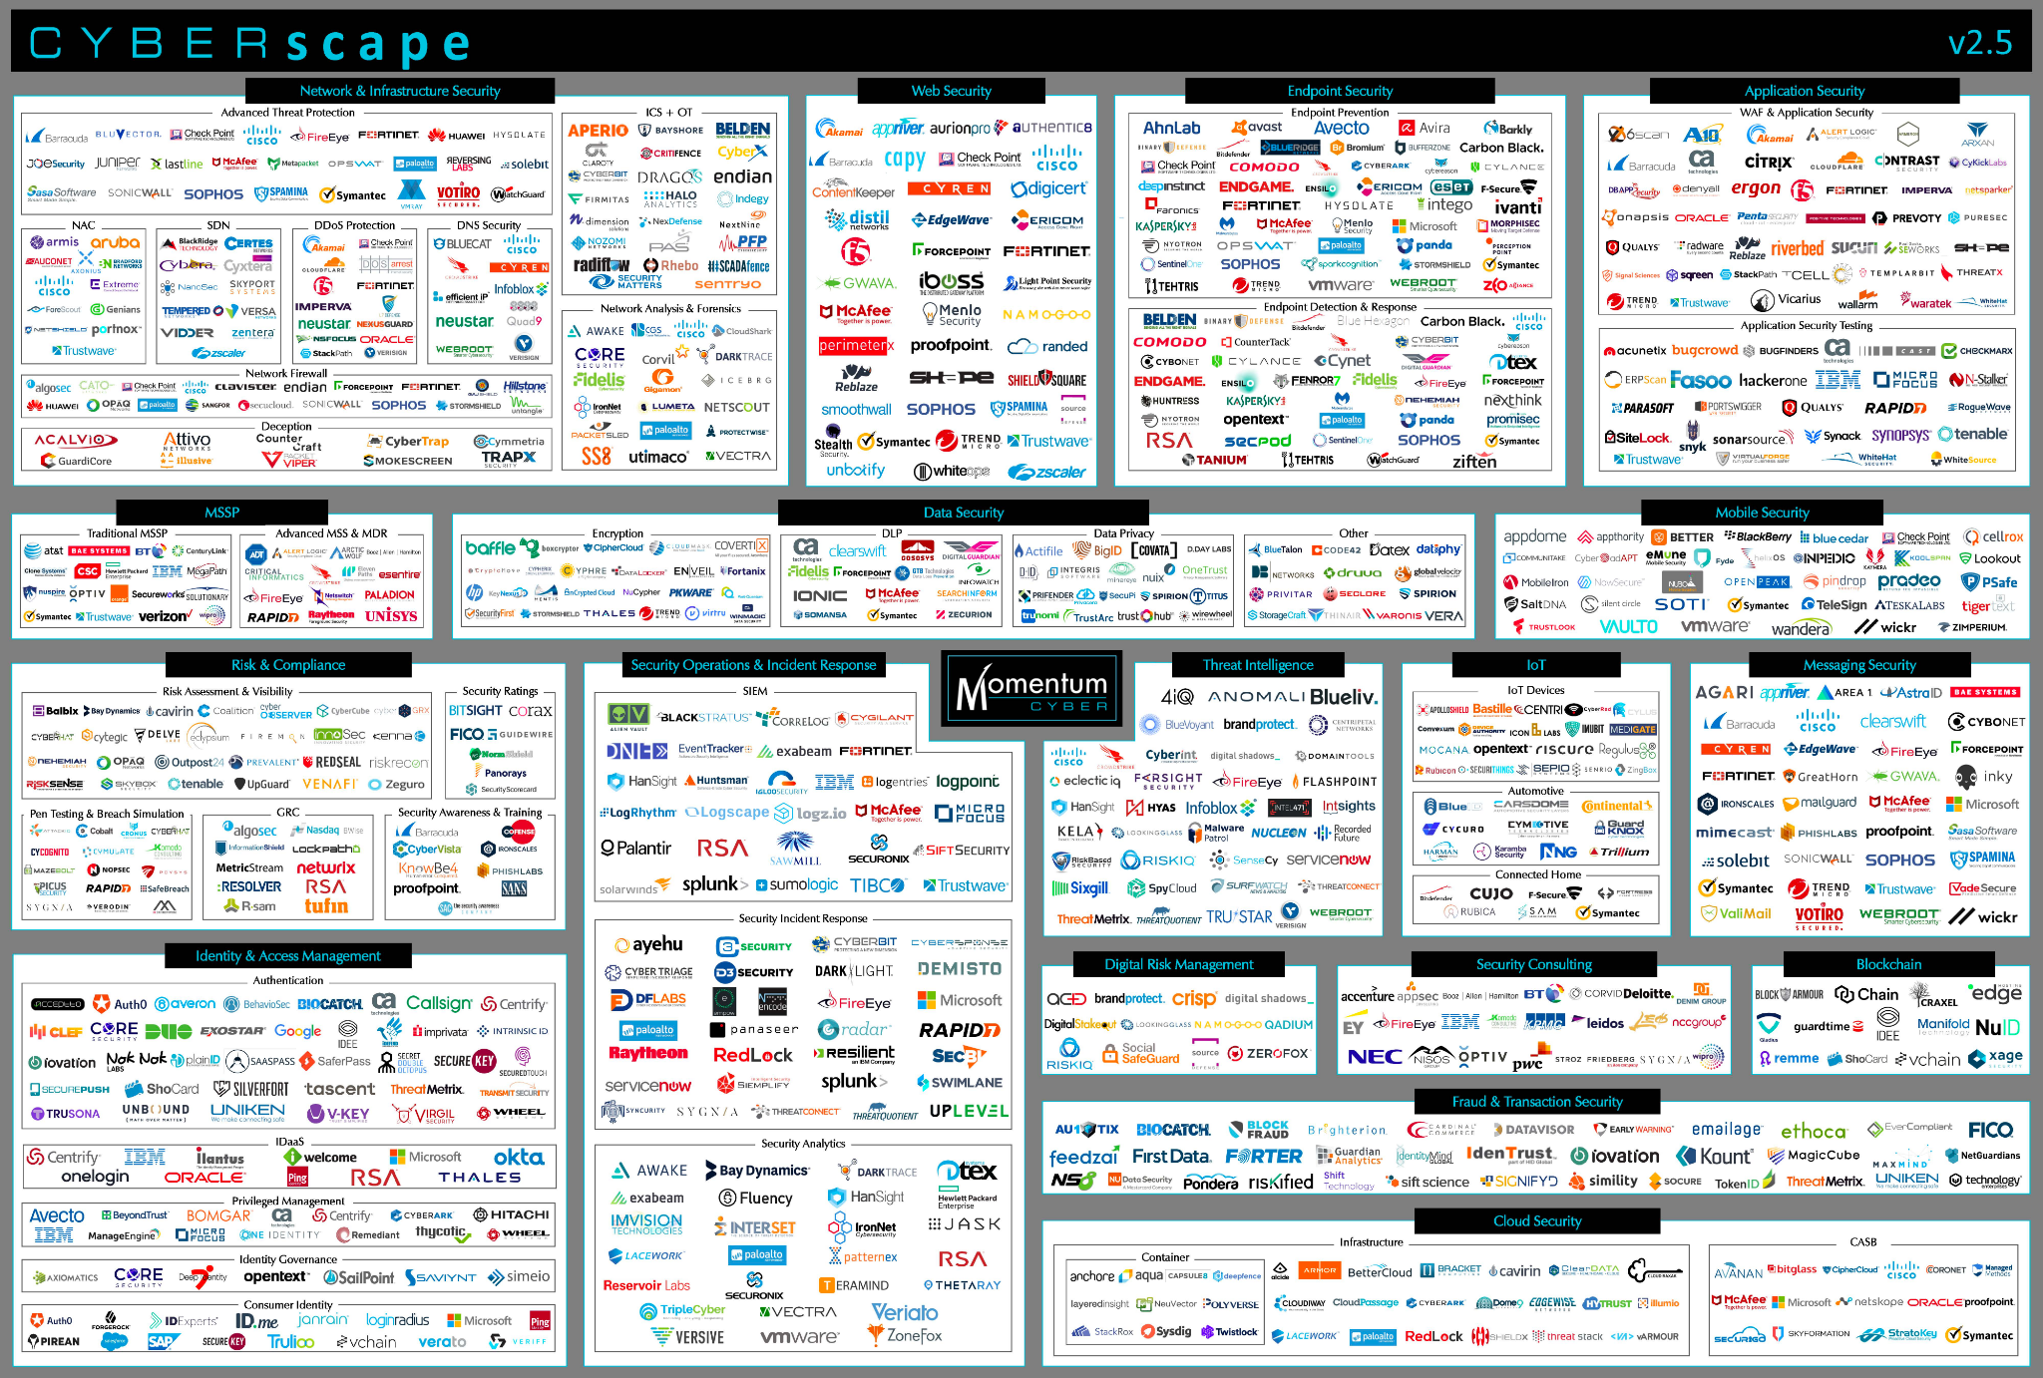
Adjacent market: Cybersecurity lumascapes

Slide 10
CogSec creator business landscape
Disinformation creators etc

Slide 11
Disinformation Actors
Persistent Manipulators
Advanced teams
Internet Research Agency
China, Iran teams etc
For-profit website networks
Antivax websites
Pink slime sites
“Stolen” US election sites
Nationstate media
Sputnik
Russia Today
Service
Providers
Disinformation as a Service
Factories
Ex-marketing, spam etc
Ad-Hoc paid teams
EBLA Ghana
PeaceData USA
Opportunists
Wares Sellers
Clicks
T-shirts
Books etc.
Groups
Conspiracy groups
Extremists
Individuals
Attention-seekers
Jokers etc
Notes:
There are many actors in this space. We hear a lot about threat actors - these are at different scales, with different capabilities and motivations. They’re learning from each other, and they often interact - for instance, we see t-shirt sellers picking up geopolitical narratives.

Slide 12
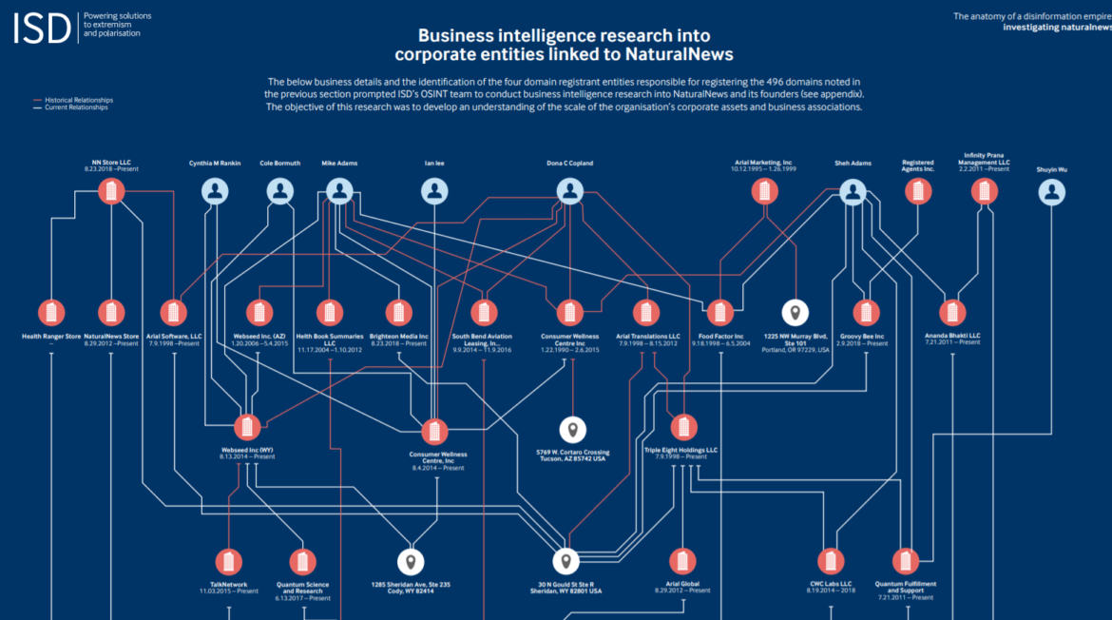
Disinformation Creation Actors
Entities behind disinformation
Nationstates
Individuals
Companies
Entities part of disinformation
DAAS companies
Image: https://gijn.org/2020/07/08/6-tools-and-6-techniques-reporters-can-use-to-unmask-the-actors-behind-covid-19-disinformation/

Slide 13
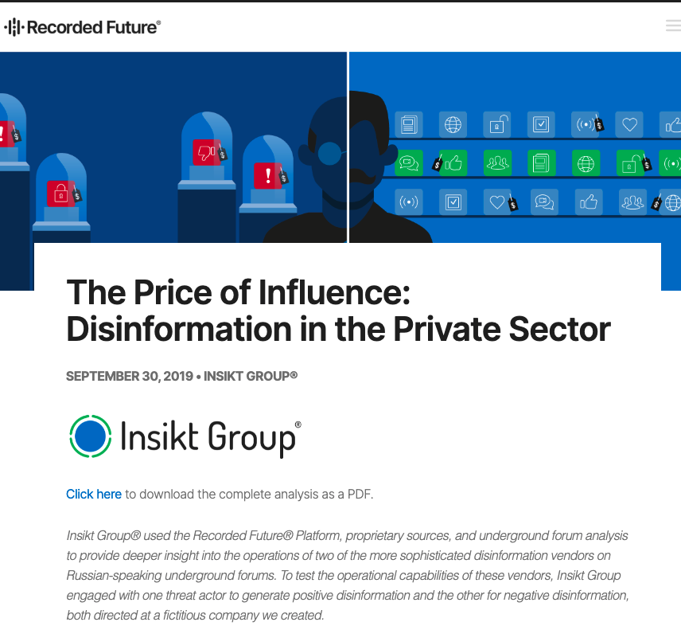
DAAS: disinfo as a service companies

Slide 14
Disinformation as a service
“Doctor Zhivago’s services were priced very specifically, as seen below:
$15 for an article up to 1,000 characters
$8 for social media posts and commentary up to 1,000 characters
$10 for Russian to English translation up to 1,800 characters
$25 for other language translation up to 2,000 characters
$1,500 for SEO services to further promote social media posts and traditional media articles, with a time frame of 10 to 15 days
Raskolnikov, on the other hand, had less specific pricing:
$150 for Facebook and other social media accounts and content
$200 for LinkedIn accounts and content
$350–$550 per month for social media marketing
$45 for an article up to 1,000 characters
$65 to contact a media source directly to spread material
$100 per 10 comments for a given article or news story”
Notes:
From https://www.recordedfuture.com/disinformation-service-campaigns/
Since then, more ex marketing, spam etc companies have joined in, and actors from countries (using fake groups as cutouts) to individuals (to sway a court case) have used DAAS services.

Slide 15
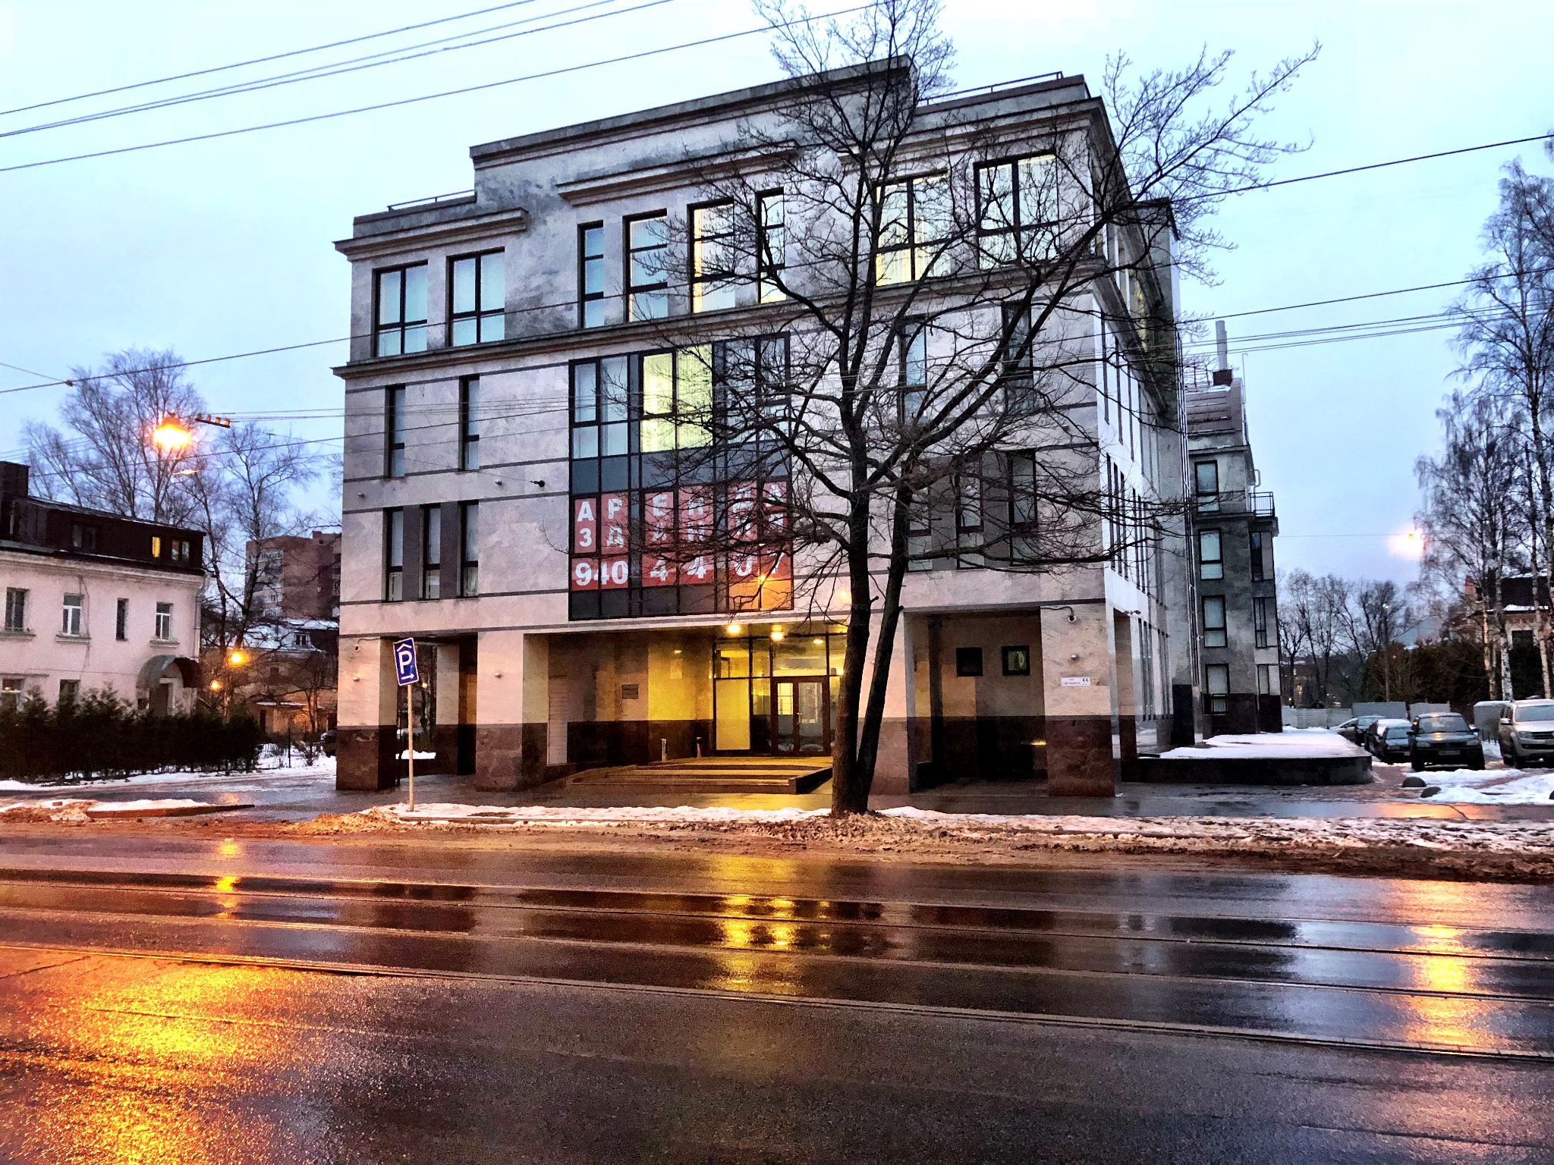
Internet Research Agency
Russian “troll farm”
Well organised
Ex marketing
Not quite official

Slide 16
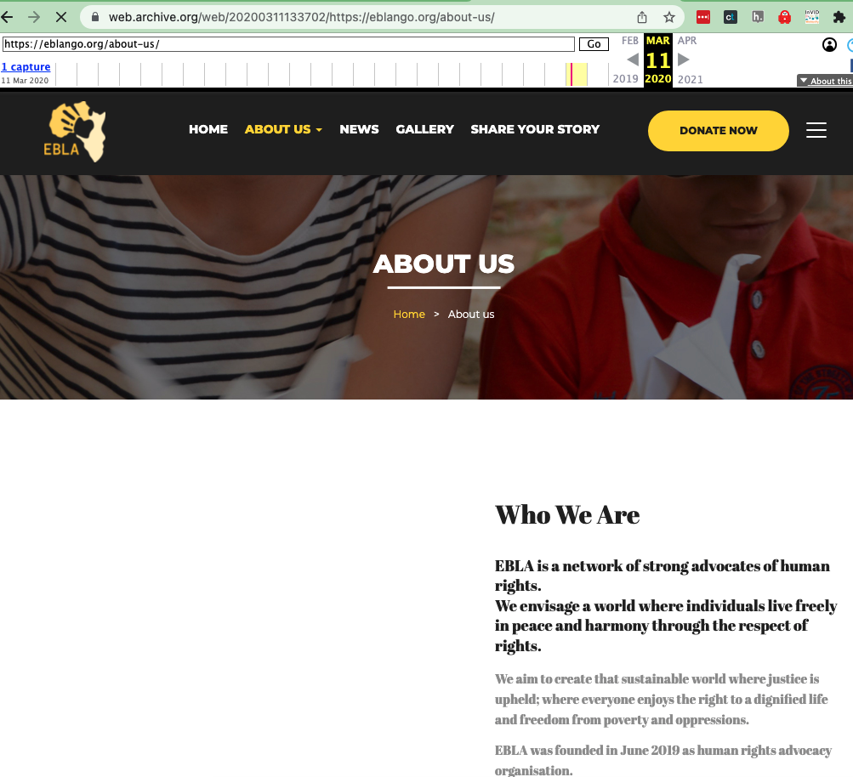
Satellite org: EBLA
Notes:
Links:
https://web.archive.org/web/20200311133702/https://eblango.org/about-us/
https://public-assets.graphika.com/reports/graphika_report_ira_in_ghana_double_deceit.pdf

Slide 17
Also
Example: Troll farms in the Philippines
PR experts plus younger social media influencers
Philippines because English-speaking workforce, used to call ceter, content moderation work
Example: PR firms, various locations
US-based: operating in other countries (Venezuela, Bolivia etc)
MAS Agency (Ukraine-based PR firm)
Saudi digital marketing firm
Notes:
Links
https://www.washingtonpost.com/world/asia_pacific/why-crafty-internet-trolls-in-the-philippines-may-be-coming-to-a-website-near-you/2019/07/25/c5d42ee2-5c53-11e9-98d4-844088d135f2_story.html
https://cyber.fsi.stanford.edu/io/news/us-pr-firm-steps-contested-elections
https://medium.com/dfrlab/facebook-removes-hyperlocal-news-pages-that-promoted-political-party-members-in-ukraine-e1073f188d60
https://cyber.fsi.stanford.edu/io/news/smaat-twitter-takedown
https://www.brookings.edu/techstream/how-disinformation-evolved-in-2020/

Slide 18
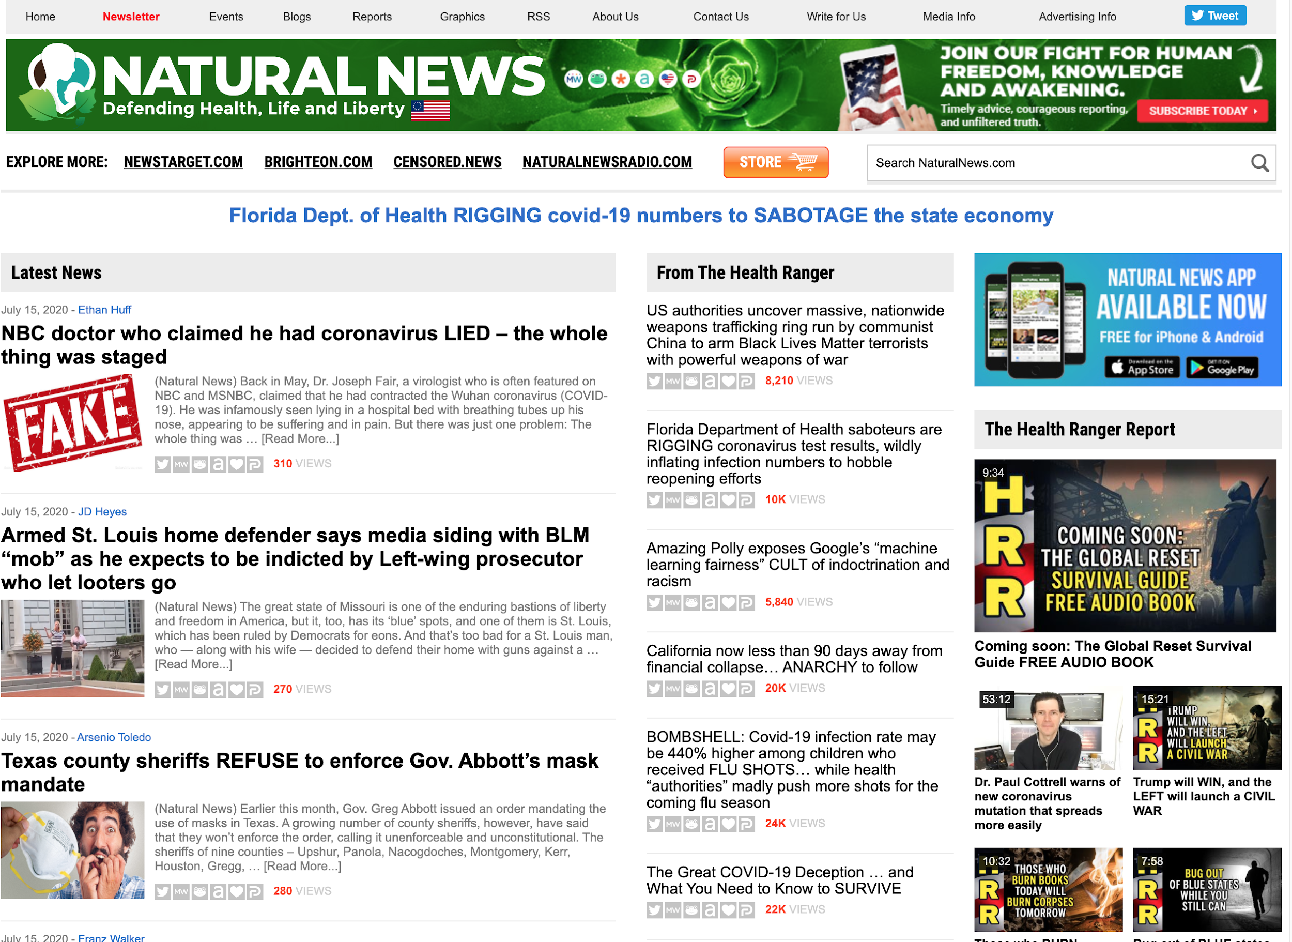
Antivax Superspreaders: NaturalNews
Notes:
Naturalnews.com and about 40 other sites in its network.

Slide 19

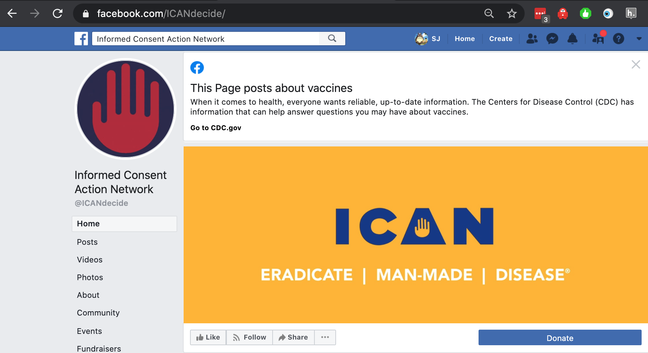
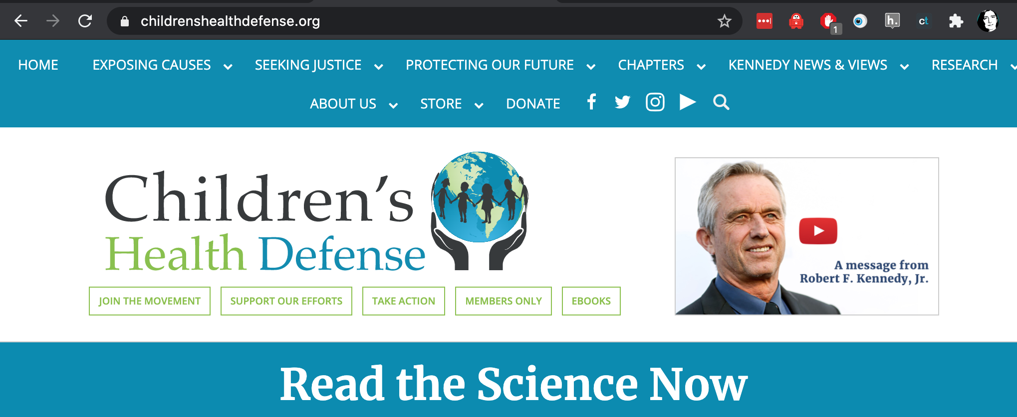
More Superspreaders
Notes:
National Vaccine Information Center, Informed Consent Action Network, Children’s Health Defense (yes, that is *that* Robert Kennedy)

Slide 20

Fake experts

Slide 21
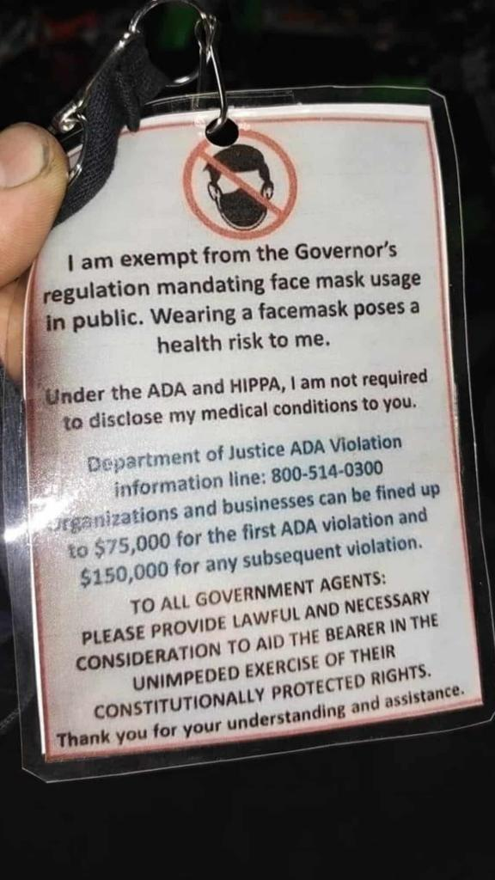
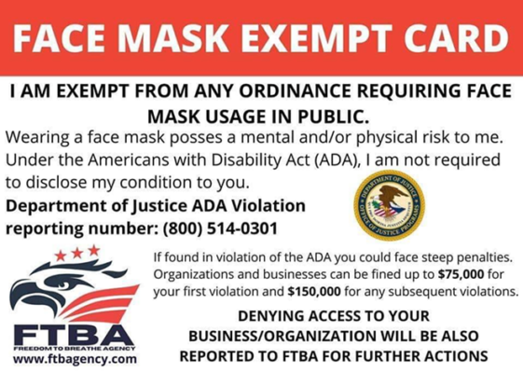
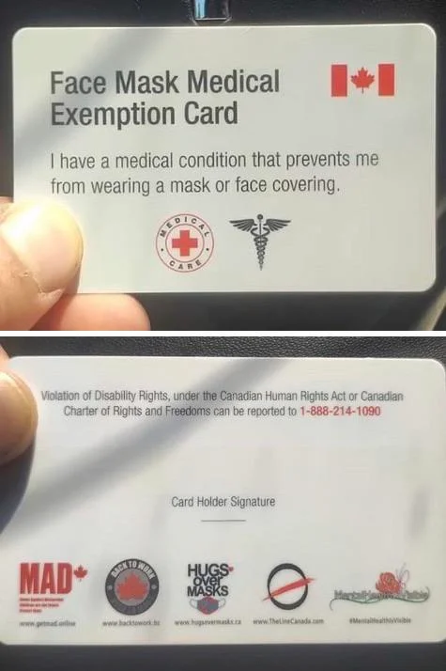
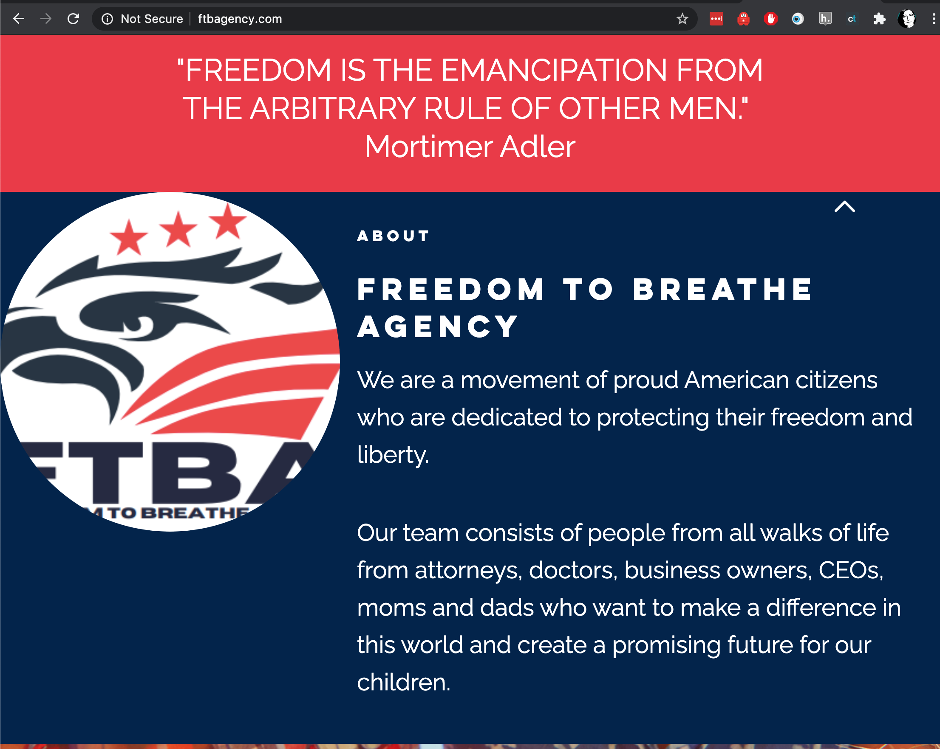
Freedom To Breathe Agency

Slide 22
CogSec creator support business landscape
Disinformation suppliers etc

Slide 23
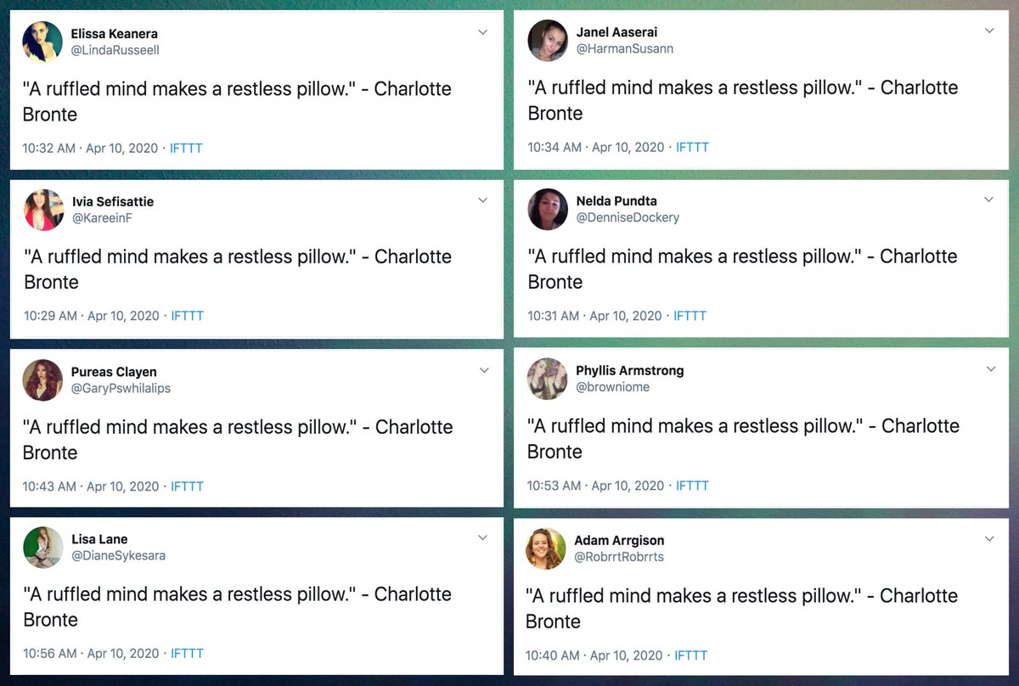
Tools
Bots/ botnets
IFTTT variants
Personas
Network analysis
Marketing tools
Deepfake generators
Image: https://twitter.com/conspirator0/status/1249020176382779392

Slide 24
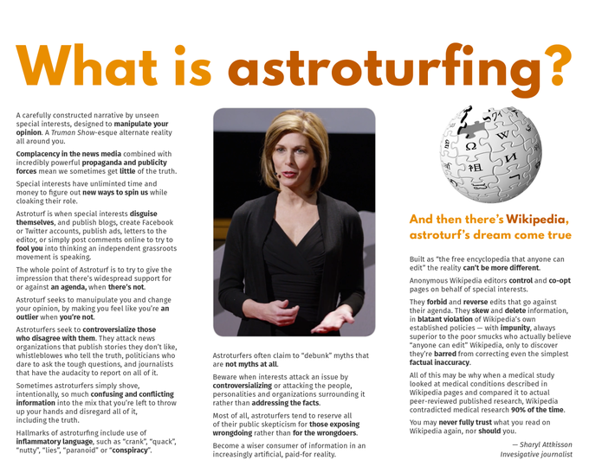
Astroturfers
Notes:
Image: https://knowyourmeme.com/photos/923510-wikipedia

Slide 25
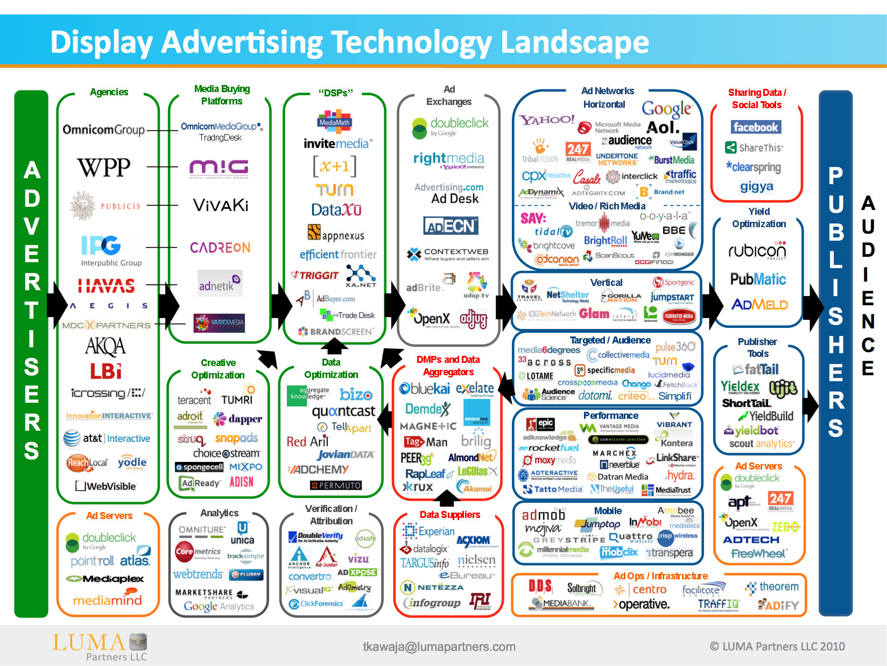
AdTech industry
Notes:
Image: https://www.adexchanger.com/venture-capital/ecosystem-map-luma-partners-kawaja/

Slide 26
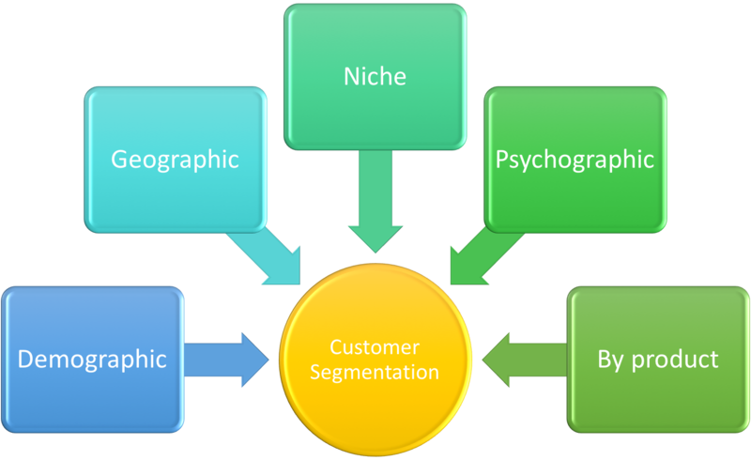
Customer segmentation and targetting
Notes:
Image: https://commons.wikimedia.org/wiki/File:Customer_Segmentation.png

Slide 27
Disinformation Creation Lumascape
Disinformation as a service
Internet Research Agency
Public relations
Fazze
Digital strategy
AP Exata
Audience growth / botnets

Slide 28
CogSec Response Business landscape
How both sides are shaping up

Slide 29
Response Actors
Disinformation SOCs
Large actors
ISAOs
Platforms
Other large actors
Event-specific
War rooms
Agencies
Disinformation Teams
Disinformation “desk"
In existing SOC
Standalone unit
Investigators
Journalists
Academics
Independent journalists
Other Responders
Policymakers
Law enforcement
Corporations
Influencers
Nonprofits
Educators
Individual researchers
Concerned citizens
Notes:
But there are also response actors in this space. These are also at different scales, with different motivations, capabilities, and connections. Our work is on how best to join these together into a coordinated rapid response.
And to do this, we’re borrowing the idea of a Security Operations Center or SOC - a coordinating unit, focussed on cognitive security, connected to other disinformation SOCs. These organizations are starting to exist. This won’t be the same for everyone, so we’re designing operations for different sizes of organization, from ISAO sized down to small teams embedded in an information security unit, to independent teams, with connections to a response network, maybe as information providers or responders.

Slide 30
Example Response Landscape
(Needs / Work / Gaps)
Risk Reduction
Media and influence literacy
information landscaping
Other risk reduction
Monitoring
Radio, TV, newspapers
Social media platforms
Tips
Response
Messaging
prebunk
debunk
counternarratives
amplification
Actions
removal
other actions
Reach
Analysis
Tier 1 (creates tickets)
Tier 2 (creates mitigations)
Tier 3 (creates reports)
Tier 4 (coordination)

Slide 31
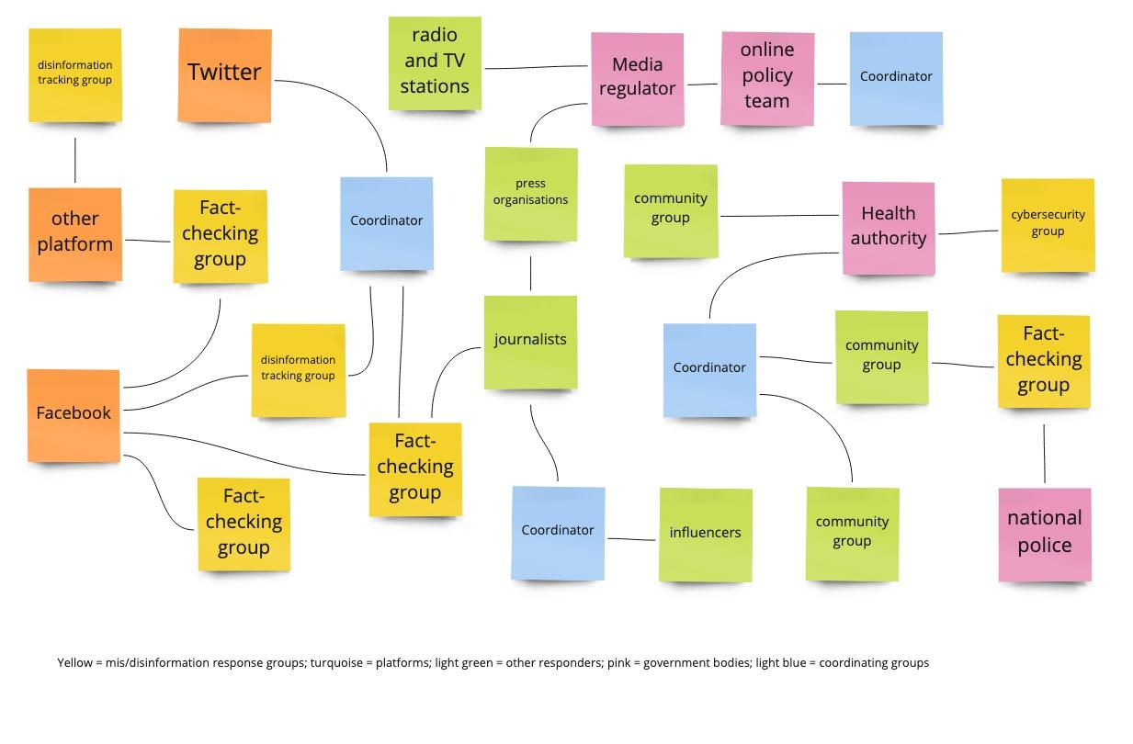
Where’s the money?

Slide 32
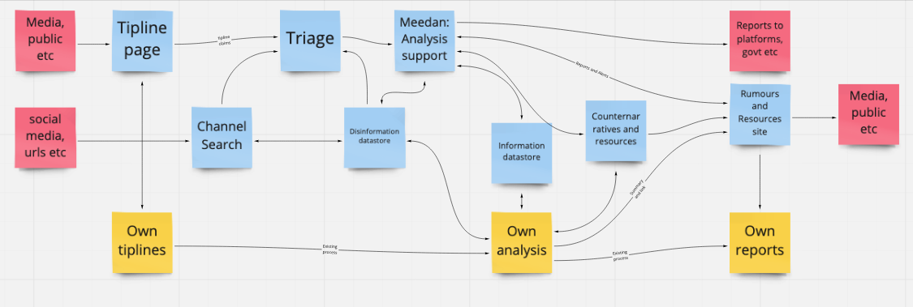
Where’s the money?
Notes:
Extra important that cross-group interfaces are efficient

Slide 33
Disinformation Response Lumascape
Advanced Threat Protection
Botnet detection and removal
Disinformation research
Fact checking
Training (inc exercises)
Information monitoring
Tools
Consultancy

Slide 34
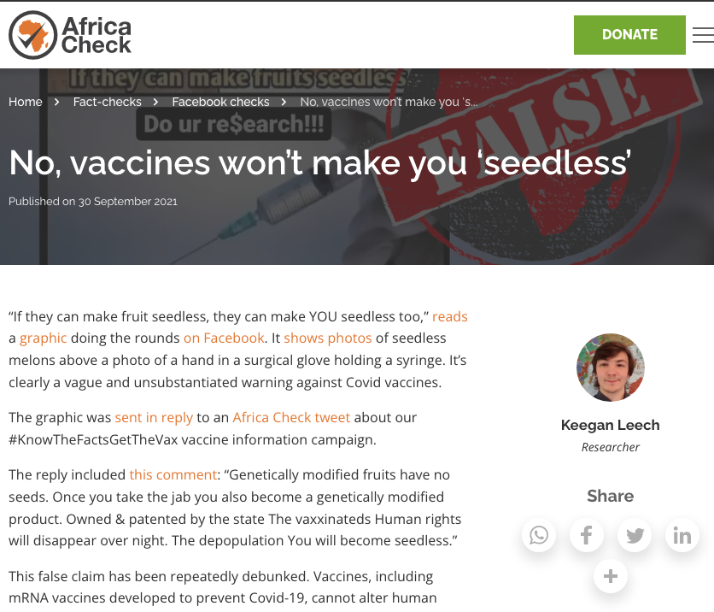
AfricaCheck / Meedan
Notes:
Image: https://africacheck.org/fact-checks/fbchecks/no-vaccines-wont-make-you-seedless

Slide 35
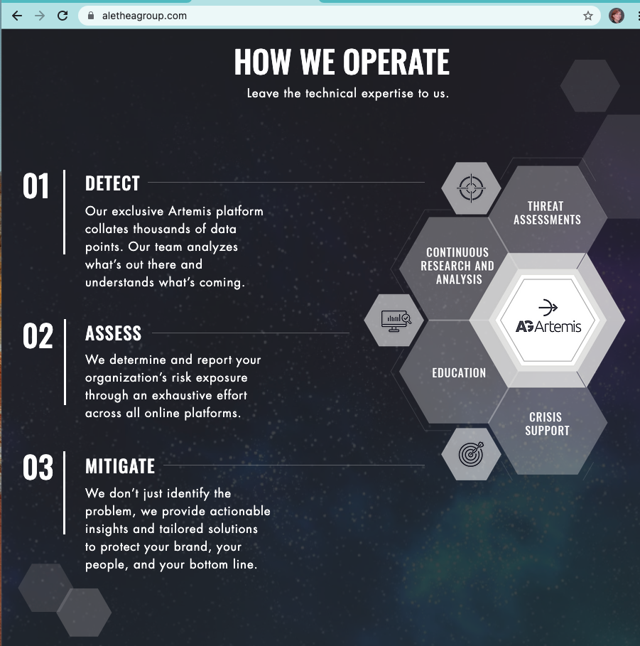
Alethea Group: threat assessments
DC-based disinformation consultancy
Techniques rooted in intelligence methods
Aimed at businesses

Slide 36
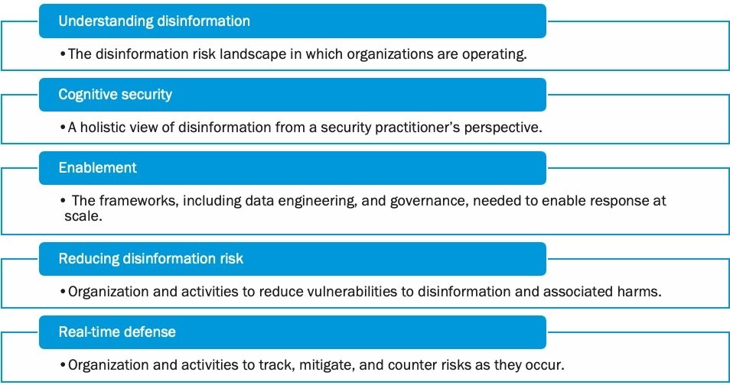
Fiveby: Adapting supply chain risk management
Seattle-based risk consultancy
Techniques rooted in fraud risk assessment
Aimed at platforms and other online businesses

Slide 37
CogSec Response Support Business landscape
Tools for responders etc

Slide 38
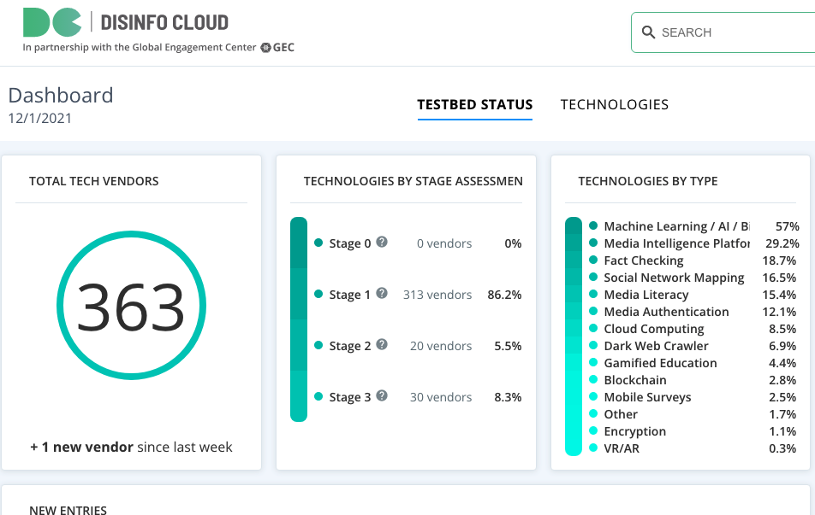
Disinformation tools market
Notes:
Links:
Disinfocloud.com

Slide 39
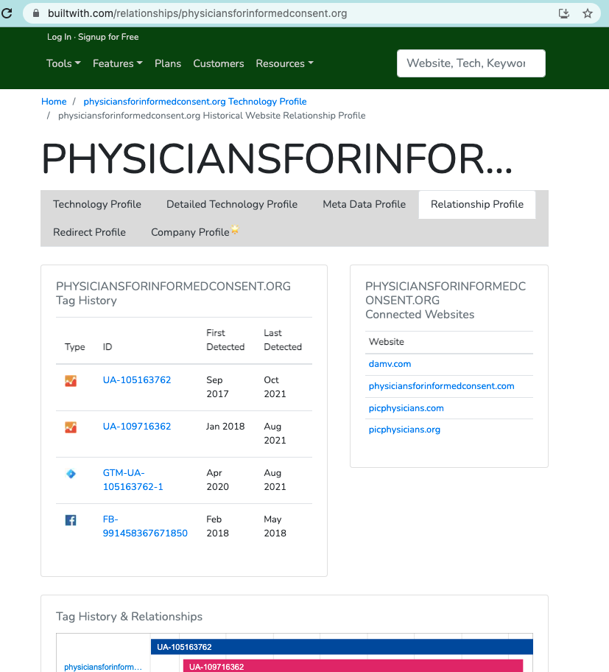
Tool: Builtwith

Slide 40
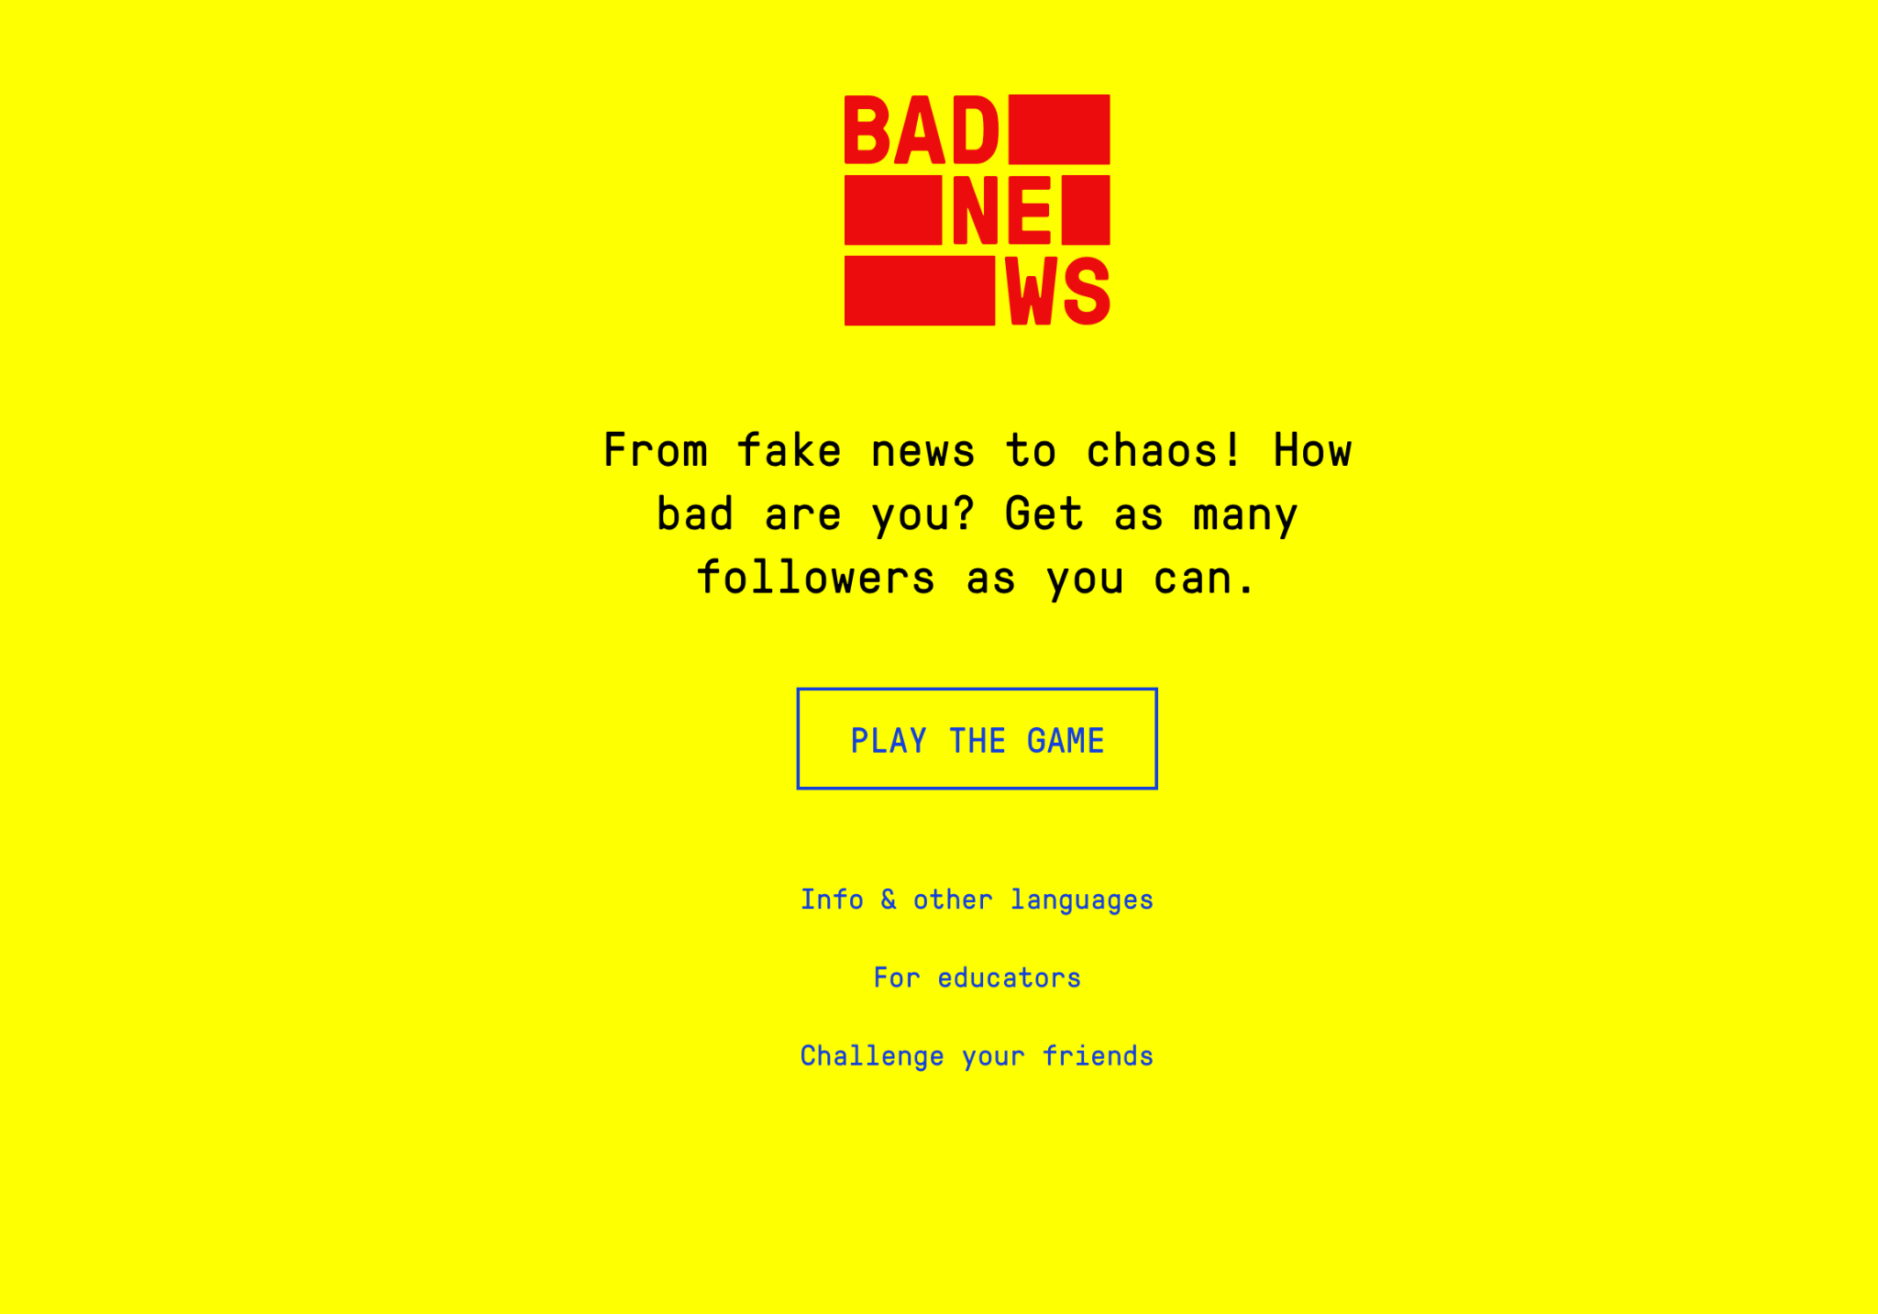
DROG: Training

Slide 41
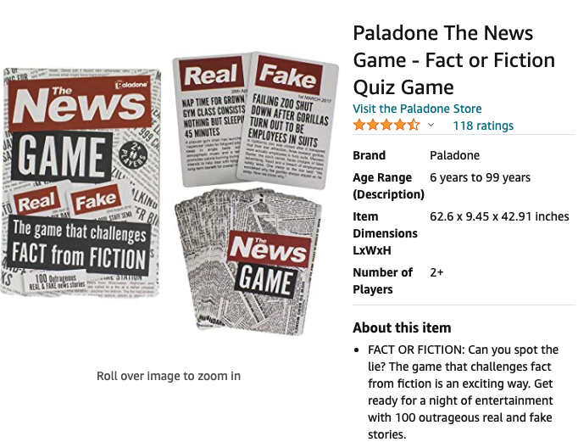

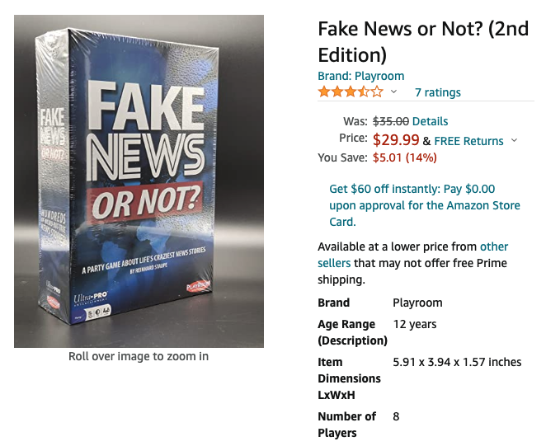
Card games - do try this at home…

